Slide 1
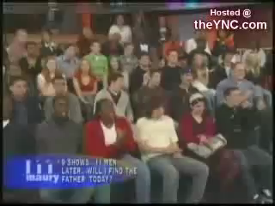

Slide 2
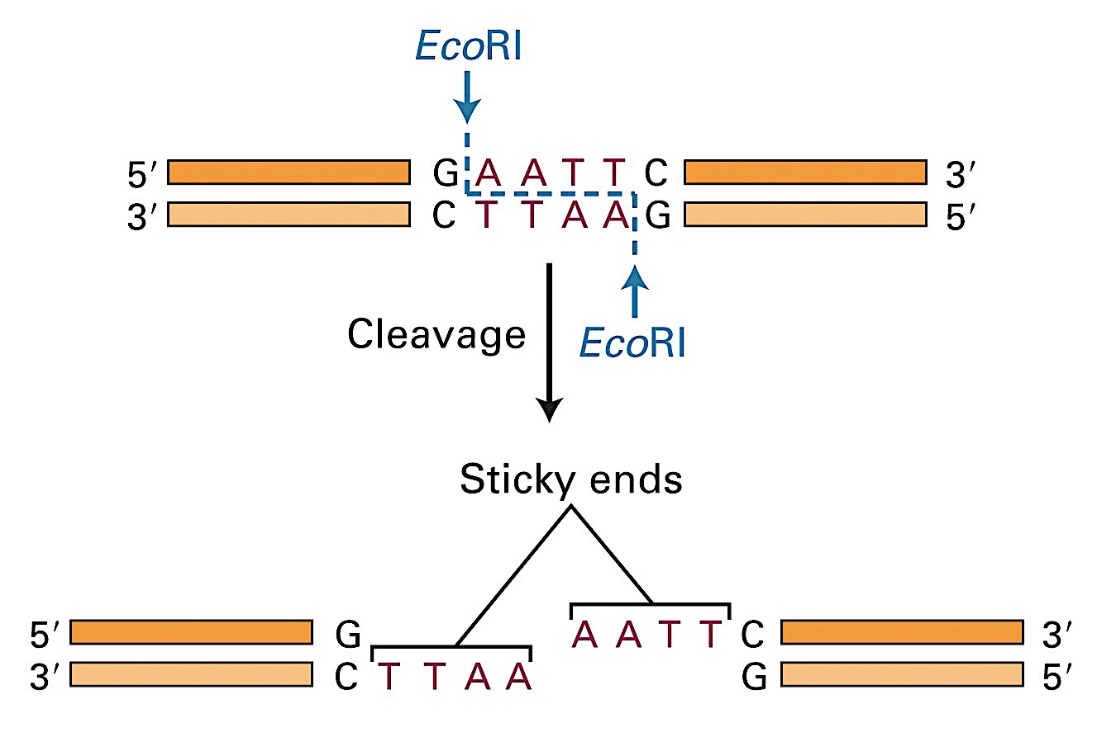
Profiling techniques
DNA is digested with special enzymes that cut at specific base sequences, leaving pieces of various lengths
These enzymes are called restriction enzymes

Slide 3
Profiling techniques
The length of these pieces varies distinctively from one person to another
EXAMPLE: ENZYME CUTS SEQUENCE AT GTTG
P1 A T C G T T G A T C G T G T T G A G A T G A C A
P2 A T C A T T G A T C G T G T T G A G A T G A C A
P3 C C A A G A T A A T T T G A T G A T G C G C T C

Slide 4
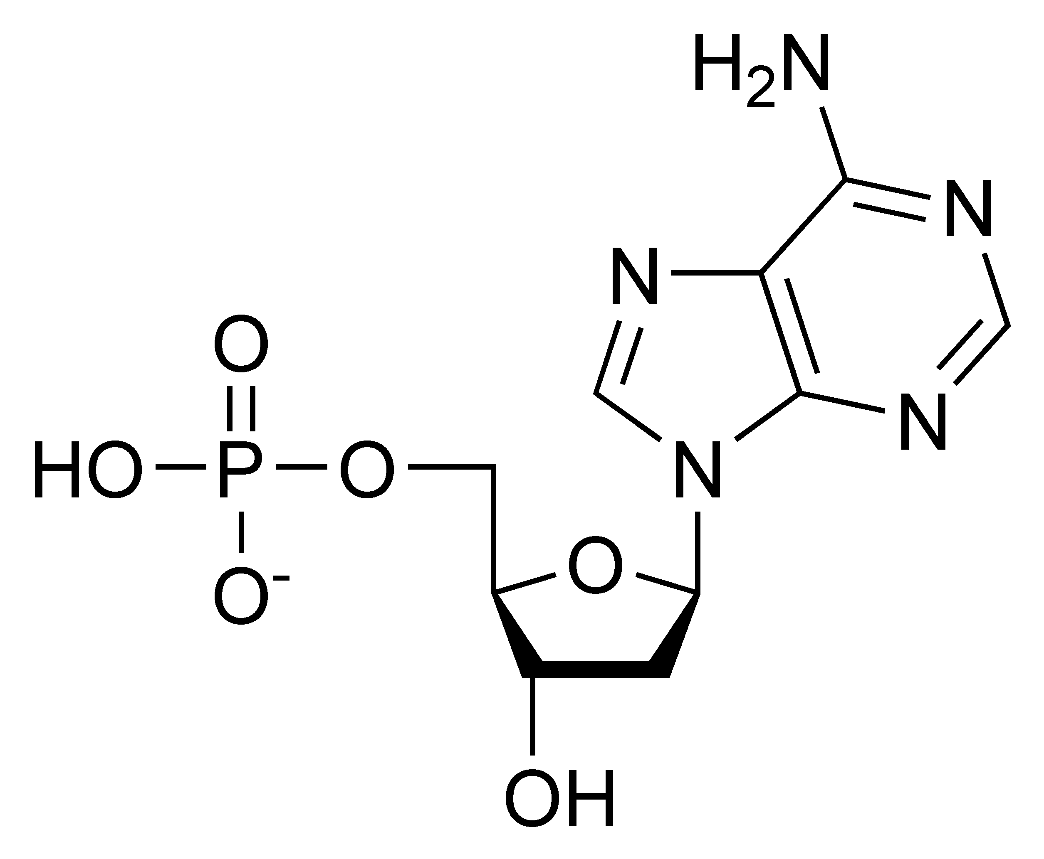
Charge of DNA
Negatively charged

Slide 5
Profiling techniques
These negatively charged pieces of DNA are placed on a bed of semi-solid gel
An electric current is passed through the gel via electrodes at either end

Slide 6
Electrophoresis
The DNA which is negatively charged moves through the gel towards the positive electrode
The smaller DNA pieces move faster than the larger ones

Slide 7
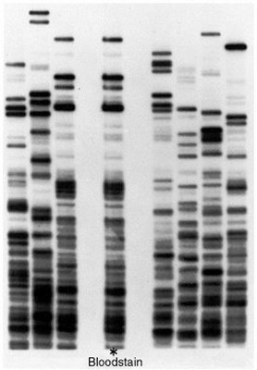
Electrophoresis
Results in a pattern of bands on the gel
DNA fingerprint/profile
the banding pattern of DNA molecules in gel electrophoresis

Slide 8
Applications
Tracing ancestry
Forensic science
Identification of hereditary diseases

Slide 9
Identifying hereditary diseases
Can be used to identify carriers of a disease gene E.g. cystic fibrosis and Huntington’s disease

Slide 10
DNA PROFILING SIMULATION!!!
http://www.pbs.org/wgbh/nova/education/body/create-dna-fingerprint.html

